Slide 1
Hand Gesture Detection for dumb and deaf Person using Machine Learning
Group No-4
Group Members-
1.Ahmed Tareque-17341009
2. Mohammad Zahirul Islam - 14101214
3.Sourav Saha Roy-13301087
4. Kazi Umme Salma Ami- 12210009
5. S.M. Naief - 14101122

Slide 2
About Our Project
WHO estimated almost 466 million people have disabling hearing loss whereas more than 63% are born deaf.
Human-computer interfaces (HCI) have evolved from text-based interfaces through 2D graphical-based interfaces, multimedia-supported interfaces.
To achieve natural human-computer interaction for VE applications, the human hand could be considered as an input device.
Vision-based hand gesture recognition techniques can be divided into two categories: appearance-based approaches and 3D hand model-based approaches .

Slide 3
Topic Overview
Our goal is to detect Hand Gesture
We will predict Hand Gesture accuracy
We will use image and convert it to CSV file
We are going to help people with disabilities

Slide 4
Dataset
We have collected dataset of a person posing sign language from different angle
We have CSV file of those images
The CSV file contains the numerical data of those images
Our dataset don’t have any null values
Our dataset has 240 rows and 5 columns
Our dataset has total 24 classes
Our dataset contain information of total 24 letters excluding J and Z.

Slide 5
Algorithms
KNN
NNET
SVM
NB
Rf

Slide 6
Algorithms
We have to classify our dataset into 24 classes.
We used classification algorithms like NNET and KNN for that purpose
We used supervised learning

Slide 7
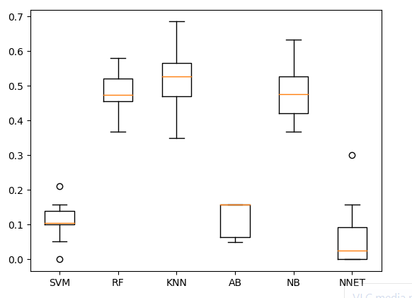
Algorithm Comparison

Slide 8
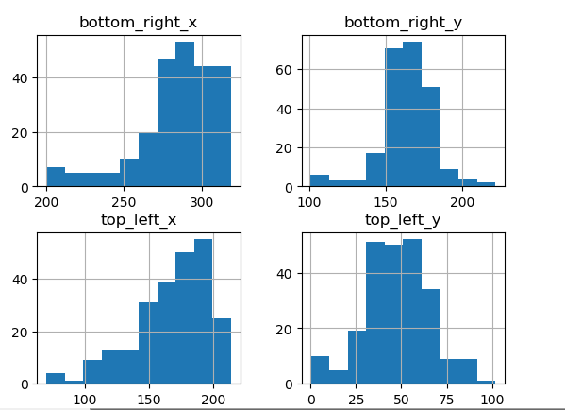
Data Visualization

Slide 9
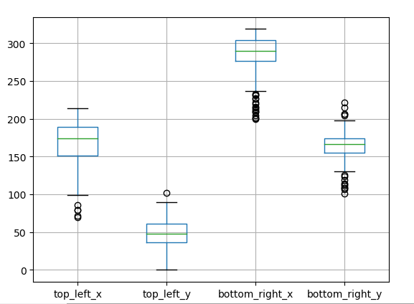
Data Visualization

Slide 10
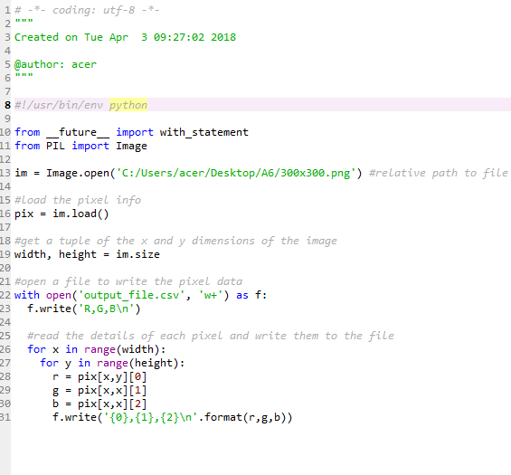
Code

Slide 11
Image to CSV
We used this code to convert Image file into CSV file
It will return Numerical value
We used PILLOW library for this purpose

Slide 12
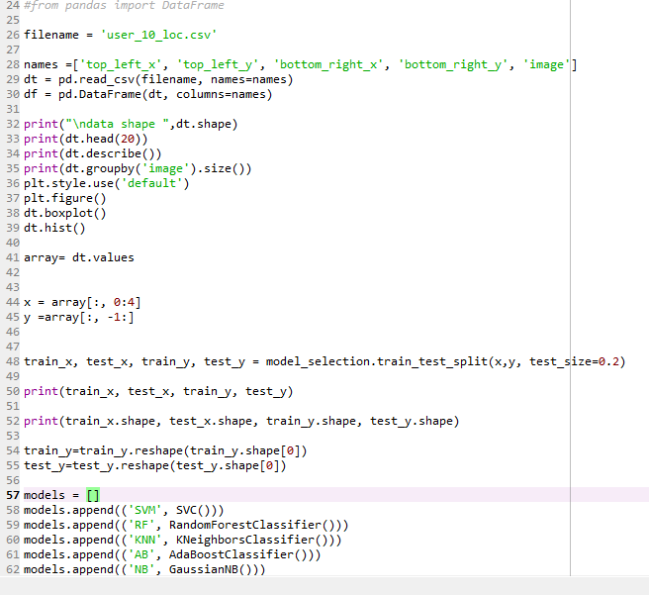
Code

Slide 13
Classification
We used this code to classify our model
We used K fold validation to avoid Overfitting
We used data visualization to understand data
We used code to see if there is any null values
We named our rows and columns
Our last row defines our class. So used class to classify our model
We split our data into two parts. Train data and test data.

Slide 14
Result and Analysis
Algorithm | Train acc | Test acc | precision | Recall | F1 Score
RF | 48% | 53.16% | 61% | 54% | 55%
KNN | 51% | 45.83% | 47% | 46% | 42%
NB | 47% | 45.83% | 49% | 46% | 45%

Slide 15
Conclusion
We will try to implement our model for android
We will try to improve our model by detecting Hand Gesture Real Time
Then we will try to publish our paper
We are expecting a lot of people will be helped by this project but its still a model and we have to implement it for real time detection.

Slide 16
References
https://medium.freecodecamp.org/weekend-projects-sign-language-and-static-gesture-recognition-using-scikit-learn-60813d600e79
https://stackoverflow.com/questions/49070242/converting-images-to-csv-file-in-python?utm_medium=organic&utm_source=google_rich_qa&utm_campaign=google_rich_qa
https://www.quora.com/How-do-I-transform-my-image-into-CSV-using-python
https://anaconda.org/anaconda/pillow

